Slide 1
Savunma Teknolojileri Mühendislik ve Ticaret A.Ş.
STM AŞ
INTRODUCTION TO SEMANTIC WEB AND ONTOLOGIES

Slide 2
Savunma Teknolojileri Mühendislik ve Ticaret A.Ş.
Sunan
Hasan TÜRKSOY
Ankara
28 Şubat 2009
STM AŞ
INTRODUCTION TO SEMANTIC WEB AND ONTOLOGIES

Slide 3

History of the Semantic Web
Web was “invented” by Tim Berners-Lee (amongst others), a physicist working at CERN
TBL’s original vision of the Web was much more ambitious than the reality of the existing (syntactic) Web:
TBL (and others) have since been working towards realising this vision, which has become known as the Semantic Web
  E.g., article in May 2001 issue of Scientific American…
“... a goal of the Web was that, if the interaction between person and hypertext could be so intuitive that the machine-readable information space gave an accurate representation of the state of people's thoughts, interactions, and work patterns, then machine analysis could become a very powerful management tool, seeing patterns in our work and facilitating our working together through the typical problems which beset the management of large organizations.”
Notes:
[1,8]

Slide 4
Beware of the Hype
Hype seems to suggest that Semantic Web means: “semantics + web = AI”
  “A new form of Web content that is meaningful to computers will unleash a revolution of new abilities”
More realistic to think of it as meaning: “semantics + web + AI = more useful web”
  Realising the complete “vision” is too hard for now (probably)
  But we can make a start by adding semantic annotation to web resources

Slide 5
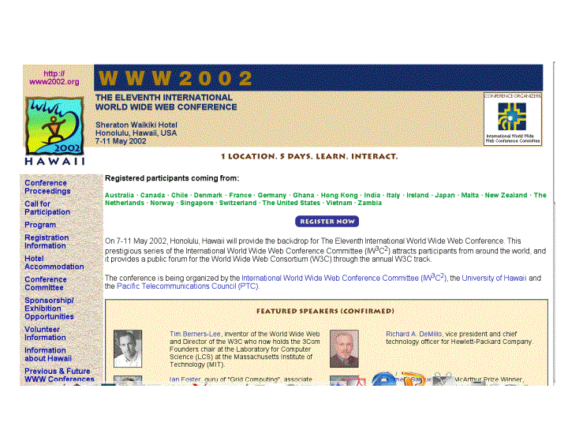
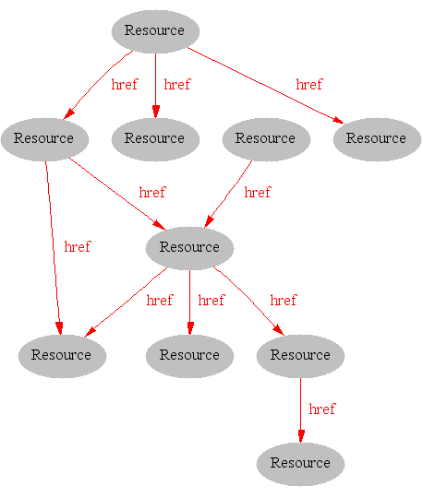
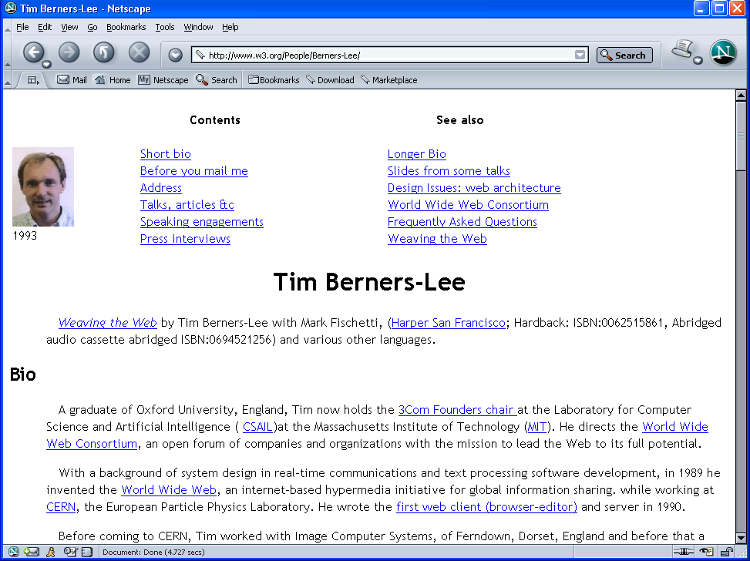
Where we are Today: the Syntactic Web
[Hendler & Miller 02]
Notes:
[1,8]

Slide 6
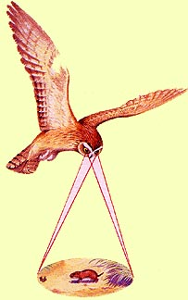
Impossible (?) using “Syntactic Web”
Complex queries involving background knowledge
  Find information about “animals that use sonar but are not either bats or dolphins”
Locating information in data repositories
  Travel enquiries
  Prices of goods and services
  Results of human genome experiments
Finding and using “web services”
  Visualize surface interactions between two proteins
Delegating complex tasks to web “agents”
  Book me a holiday next weekend somewhere warm, not too far away, and where they speak French or English
, e.g., Barn Owl

Slide 7
What is the Problem?
Consider a typical web page:
Markup consists of:
  rendering information (e.g., font size and colour)
  Hyper-links to related content
Semantic content is accessible to humans but not (easily) to computers…
Notes:
[1,8]

Slide 8
What information can we see…
WWW2002
The eleventh international world wide web conference
Sheraton waikiki hotel
Honolulu, hawaii, USA
7-11 may 2002
1 location 5 days learn interact
Registered participants coming from
australia, canada, chile denmark, france, germany, ghana, hong kong, india, ireland, italy, japan, malta, new zealand, the netherlands, norway, singapore, switzerland, the united kingdom, the united states, vietnam, zaire
Register now
On the 7th May Honolulu will provide the backdrop of the eleventh international world wide web conference. This prestigious event …
Speakers confirmed
Tim berners-lee
Tim is the well known inventor of the Web, …
Ian Foster
Ian is the pioneer of the Grid, the next generation internet …
Notes:
[1]
9-13 arasındaki çorba kodlar gösterilmeyebilir:...!? – [8]’deki gibi olabilir...

Slide 9
What information can a machine see…




  




…


…

…
Notes:
[1]

Slide 10
Solution: XML markup with “meaningful” tags?
<name>
</name>
<location>
</location>
<date>  </date>
<slogan></slogan>
<participants>
</participants>
<introduction>
…
</introduction>
<speaker></speaker>
<bio></bio>…

Slide 11
Giving Semantics to Annotations
External agreement on meaning of annotations
  Agree on meaning of a set of annotation tags
    E.g., Dublin Core
  Limited flexibility and extensibility
  Limited number of things can be expressed
Use Ontologies to specify meaning of annotations
  Agree on language used to describe meaning
  Meanings of vocabularies of terms given by ontologies
    New terms can be formed by combining existing ones
    Meaning (semantics) of such terms is formally specified
    Can combine/relate terms in multiple ontologies
Notes:
[1,8]
Big Apple is a large fruit or a city? [8]

Slide 12
Ontological Vision of Semantic Web
Semantic Web needs ontologies
An ontology is
  document or file that formally and in a standardized way defines the hierarchy of classes within the domain, semantic relations among terms and inference rules
Notes:
[3,8]

Slide 13
Why Develop an Ontology?
To share common understanding of the structure of descriptive information
  among people
  among software agents
  between people and software
To enable reuse of domain knowledge
  to avoid “re-inventing the wheel”
  to introduce standards to allow interoperability
Notes:
[5]

Slide 14
An Ontology should be just the Beginning
Databases
Ontologies
Declare
structure
Knowledge
bases
The “Semantic
Web”
Provide
domain
description
Software agents
Problem-solving methods
Domain-independent
applications
Notes:
[5]

Slide 15
Ontology Examples
Taxonomies on the Web
  Yahoo! Categories
Catalogs for on-line shopping
  Amazon.com product catalog
Dublin Core and other standards for the Web
Domain independent examples
  Ontoclean
  Sumo
Notes:
[5]
TODO : ontologies in military

Slide 16


Semantic Web basics...
RDF:
  stands for Resource Description Framework
  is a W3C standard, which provides tool to describe Web resources
  provides interoperability between applications that exchange machine-understandable information
RDF Schema:
  is a W3C standard which defines vocabulary for RDF
  organizes this vocabulary in a typed hierarchy (Class, Property, type, subClassOf, subPropertyOf, range, domain)
  capable to explicitly declare semantic relations between vocabulary terms
Notes:
[3,4]

Slide 17
RDF and RDFS
RDF stands for Resource Description Framework
It is a W3C candidate recommendation (http://www.w3.org/RDF)
RDF is graphical formalism ( + XML syntax + semantics)
  for representing metadata
  for describing the semantics of information in a machine- accessible way
RDFS extends RDF with “schema vocabulary”, e.g.:
  Class, Property
  type, subClassOf, subPropertyOf
  range, domain
Notes:
[4]

Slide 18




RDF – Semantic Web over Web Resources
John
Director
has_homepage
has_job
Ontology
to_be_in_love_with
has_job
has_homepage
Secretary
Mary
Notes:
[3]

Slide 19
The RDF Data Model
Statements are <subject, predicate, object> triples:
Ian
hasColleague
Uli
Can be represented using XML serialisation, e.g.:
  <Ian,hasColleague,Uli>
Statements describe properties of resources
Properties themselves are also resources (URIs)
A resource is a URI representing a (class of) object(s):
  a document, a picture, a paragraph on the Web;
  http://www.cs.man.ac.uk/index.html
  a book in the library, a real person (?)
  isbn://5031-4444-3333
  …

Slide 20
RDF Schema (RDFS)
RDF gives a formalism for meta data annotation, and a way to write it down in XML, but it does not give any special meaning to vocabulary such as subClassOf or type
  Interpretation is an arbitrary binary relation
  I.e., <Person,subClassOf,Animal> has no special meaning
RDF Schema defines “schema vocabulary” that supports definition of ontologies
  gives “extra meaning” to particular RDF predicates and resources (such as subClasOf)
  this “extra meaning”, or semantics, specifies how a term should be interpreted
Notes:
[4]

Slide 21
RDFS Examples
RDF Schema terms (just a few examples):
  Class
  Property
  type
  subClassOf
  range
  domain
These terms are the RDF Schema building blocks (constructors) used to create vocabularies:
  <Person,type,Class>
  <hasColleague,type,Property>
  <Professor,subClassOf,Person>
  <Carole,type,Professor>
  <hasColleague,range,Person>
  <hasColleague,domain,Person>
Notes:
[4] + class diagram ve owl kodu ekle

Slide 22
Problems with RDFS
RDFS too weak to describe resources in sufficient detail
  No localised range and domain constraints
    Can’t say that the range of hasChild is person when applied to persons and elephant when applied to elephants
  No existence/cardinality constraints
    Can’t say that all instances of person have a mother that is also a person, or that persons have exactly 2 parents
  No transitive, inverse or symmetrical properties
    Can’t say that isPartOf is a transitive property, that hasPart is the inverse of isPartOf or that touches is symmetrical
  …
Difficult to provide reasoning support
  No “native” reasoners for non-standard semantics
  May be possible to reason via FO axiomatisation
Notes:
[4]

Slide 23
OWL became standard
10 February 2004 the World Wide Web Consortium announced final approval of two key Semantic Web technologies, the revised Resource Description Framework (RDF) and the Web Ontology Language (OWL).
Read more in:
http://www.w3.org/2004/01/sws-pressrelease.html.en
Notes:
[3]
OWL language now a w3c recommendadion (i.e., a standard like HTML and XML)

Slide 24
OWL Introduction
What is OWL?
  OWL is a language for defining Web Ontologies and their associated Knowledge Bases
  The OWL language is a revision of the DAML+OIL web ontology language incorporating learning from the design and application use of DAML+OIL.
  OWL extends RDFS vocabulary and adds axioms.
  OIL, DAML+OIL and OWL based on Description Logics
Notes:
[3]

Slide 25
Description Logic Family
DLs are a family of logic based Knowledge Representation formalisms
Particular languages mainly characterized by:
  Set of constructors for building complex concepts and roles from simpler ones
  Set of axioms for asserting facts about concepts, roles and individuals
Examples:
  “Female persons”
    Person ⊓ Female
  “Non-female persons”
    Person ⊓ ¬Female
  “Persons that have a child”
    Person ⊓ ∃hasChild.Person
  “Persons all of whose children are female”
    Person ⊓ ∀hasChild.Female
  “Persons that are employed or self-eployed”
    Person ⊓ (Employee ⊔ SelfEmployed)
  “Persons that have at most one father“
    Person ⊓ ≤1.hasFather
Notes:
[6]

Slide 26
OWL RDF/XML Exchange Syntax
<owl:Class>
<owl:intersectionOf rdf:parseType=" collection">
<owl:Class rdf:about="#Parent"/>
<owl:Restriction>
<owl:onProperty rdf:resource="#hasChild"/>
<owl:allValuesFrom>
<owl:unionOf rdf:parseType=" collection">
<owl:Class rdf:about="#Intelligent"/>
<owl:Class rdf:about="#Athletic"/>
</owl:unionOf>
</owl:allValuesFrom>
</owl:Restriction>
</owl:intersectionOf>
</owl:Class>
E.g.; HappyParent ´ Parent u 8hasChild.(Intelligent t Athletic):

Slide 27
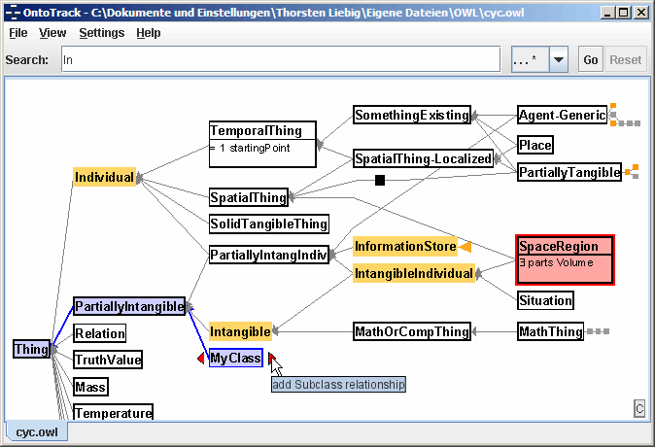
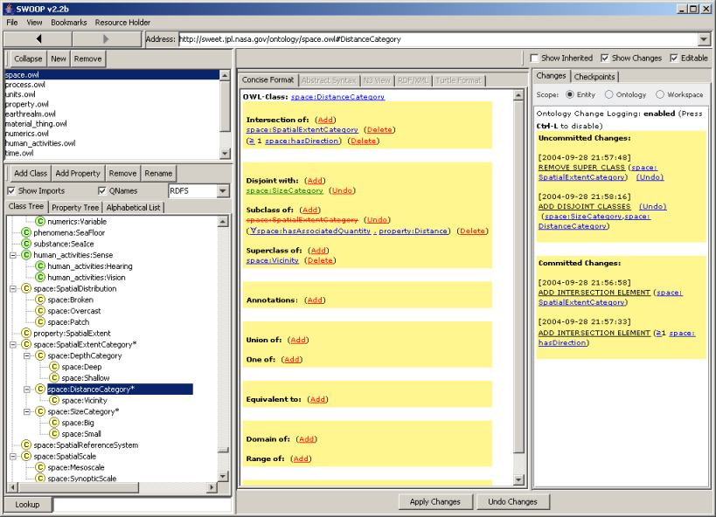
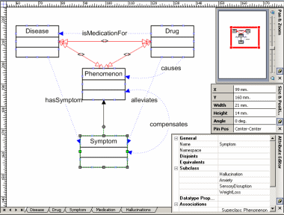
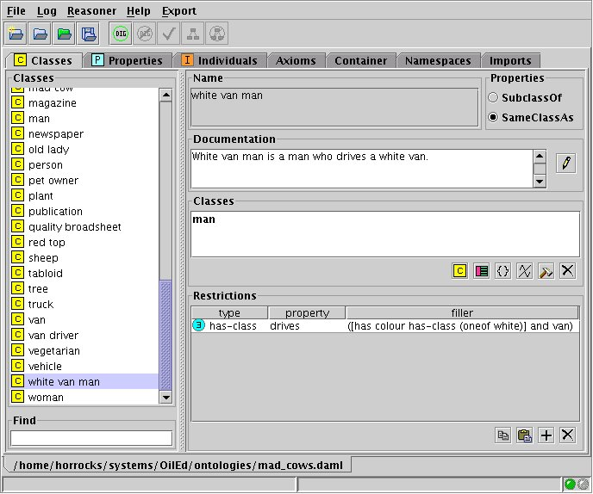
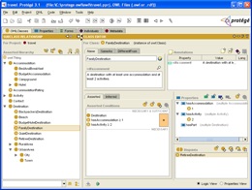
Tools and Infrastructure
Editors/environments
  Oiled, Protégé, Swoop, Construct, Ontotrack, …
Notes:
[8]

Slide 28




Tools and Infrastructure
Editors/environments
  Oiled, Protégé, Swoop, Construct, Ontotrack, …
Reasoning systems
  Cerebra, FaCT++, Kaon2, Pellet, Racer, …
Pellet
Notes:
[8]

Slide 29
Summary
Semantic Web aims to make web content more accessible to automated processes
  Adds semantic annotations to web resources
Ontologies provide vocabulary for annotations
  Terms have well defined meaning
OWL ontology language based on (description) logic
  Exploits results of basic research on complexity, reasoning, etc.
Many research challenges remain
  Including expressive power, scalability and tools
Notes:
[8]

